Slide 1
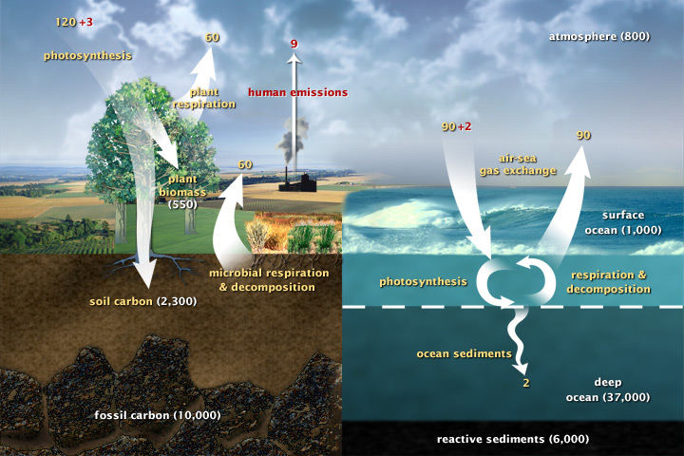
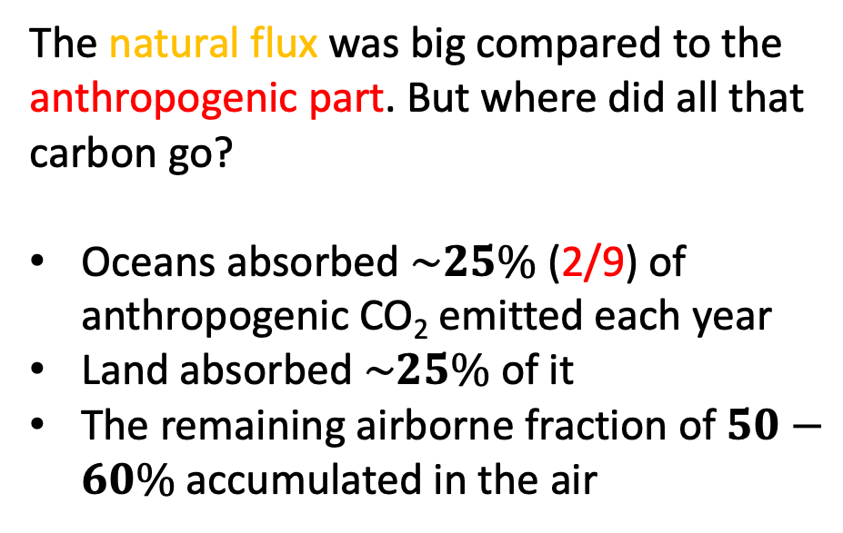
Gobal carbon fluxes
Global carbon fluxes, year 2005
The natural flux was big compared to the anthropogenic part. But where did all that carbon go?
Oceans absorbed $\sim 25\%$(2/9) of anthropogenic CO₂ emitted each year
Land absorbed $\sim 25\%$of it
The remaining airborne fraction of $50−60\%$ accumulated in the air
https://earthobservatory.nasa.gov/features/CarbonCycle
0:00 / 3:10 NASA | A Year in the Life of Earth's CO2

Slide 2
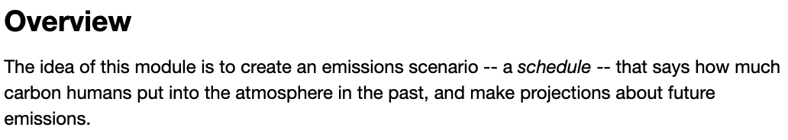
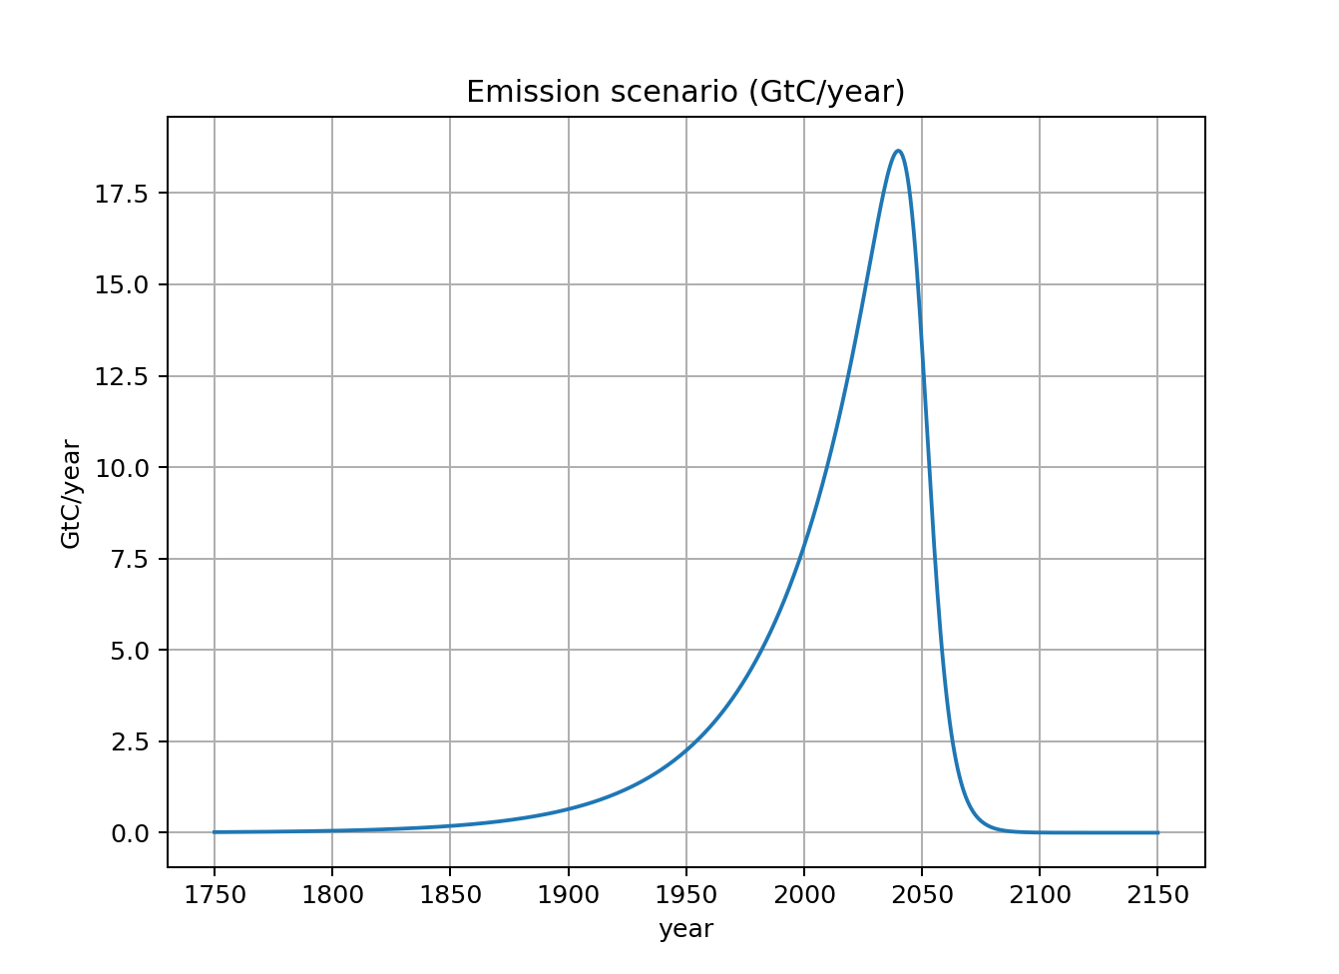

Introduction to scheduled flows

Slide 3
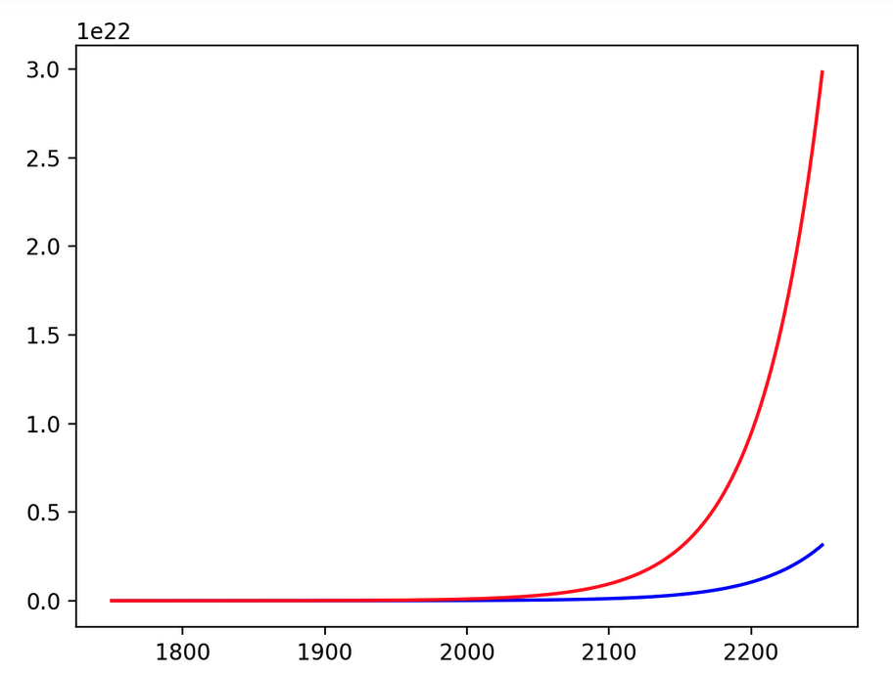
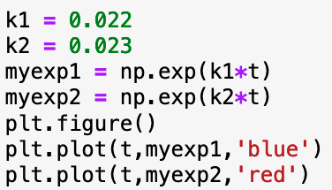


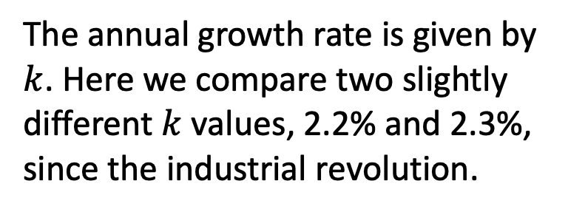
Early growth is assumed to be exponential
The annual growth rate is given by $k$. Here we compare two slightly different $k$ values, 2.2% and 2.3%, since the industrial revolution.
$$exp⁡(kt)$$
$$t$$

Slide 4
Exponential growth is characterized by a doubling time
Start at some time
$$exp⁡(kt)$$
$$t$$

Slide 5
Exponential growth is characterized by a doubling time
Doubles after 30 years
$$exp⁡(kt)$$
$$t$$

Slide 6
Exponential growth is characterized by a doubling time
Doubles again after another 30 years!
$$exp⁡(kt)$$
$$t$$

Slide 7
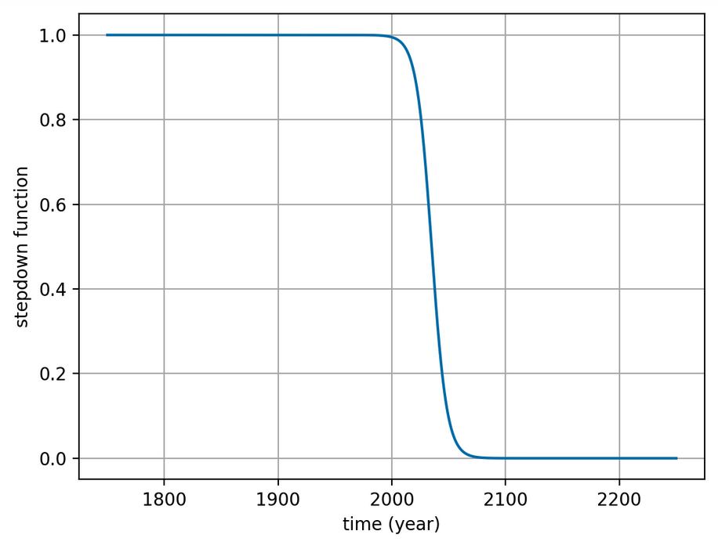
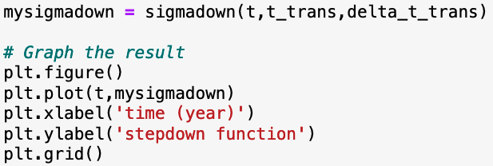

Decarbonization is assumed to follow a step-down sigmoid function
$$σ_{down}$$

Slide 8
Decarbonization is assumed to follow a step-down sigmoid function
$$σ_{down}$$
t is an array of times
t_trans is the transition year (2040)
delta_t_trans is the transition time (20 years*)
Meaning, it takes 20 years to go from .8 to .2 (the “80/20 rule”)

Slide 9
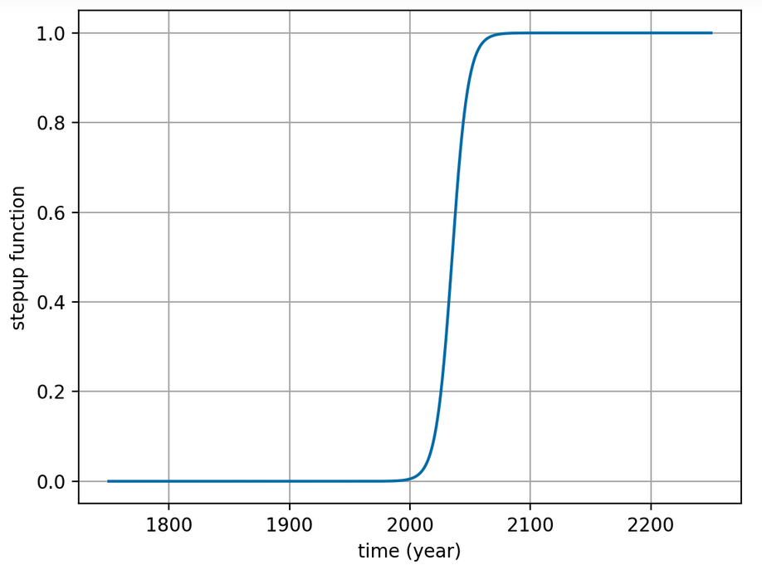
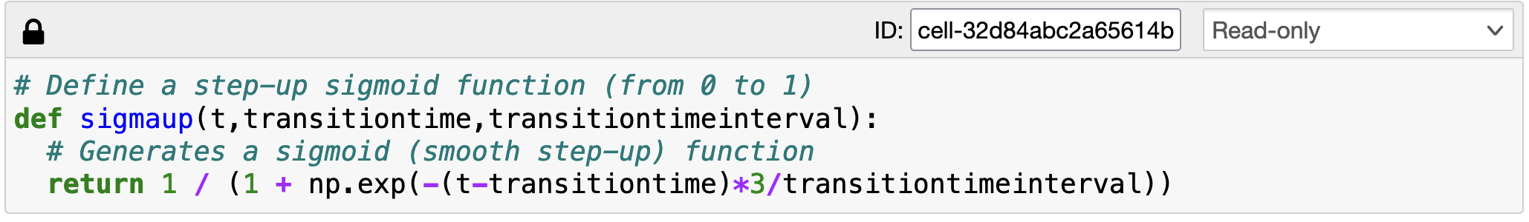

“Scaffolded learning” => you get the $σ_{up}$ function
$$σ_{up}$$

Slide 10

You have to write $σ_{down}$
$$σ_{up}$$
$$σ_{down}$$

Slide 11
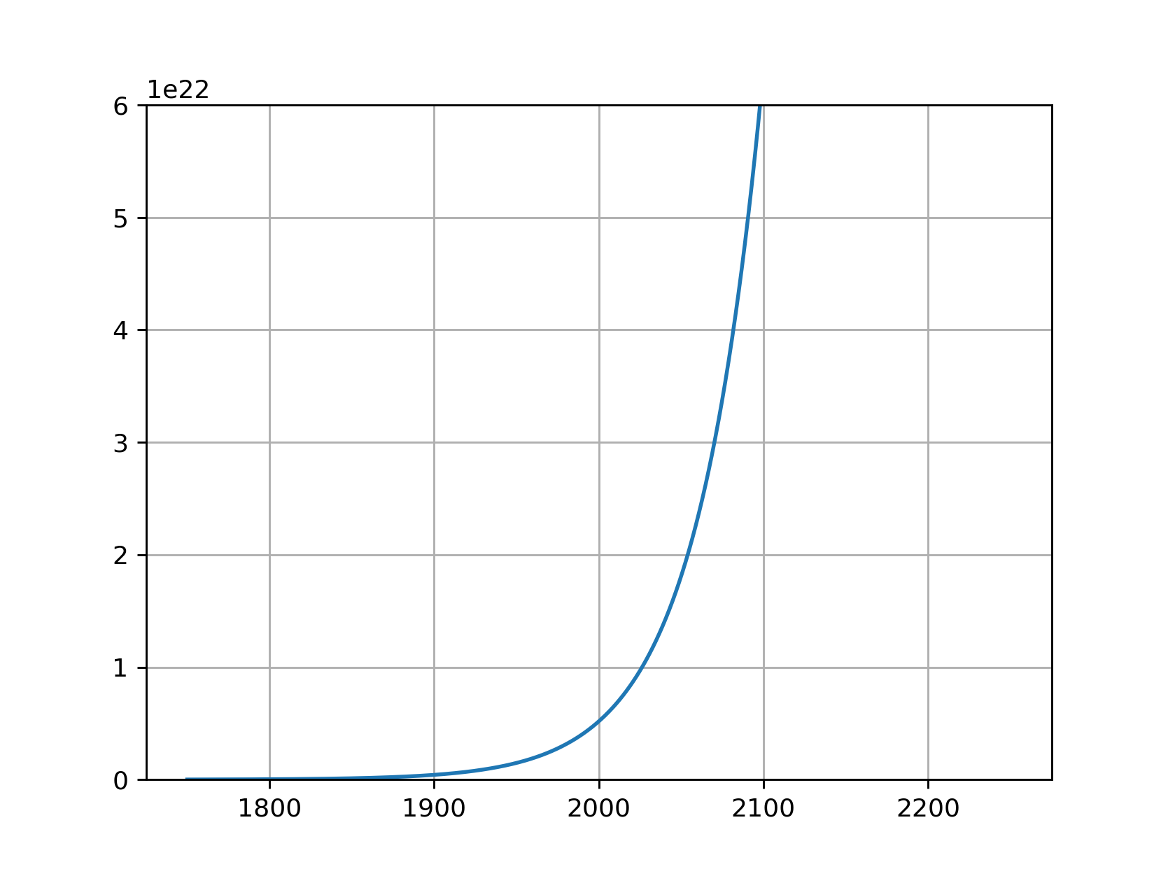
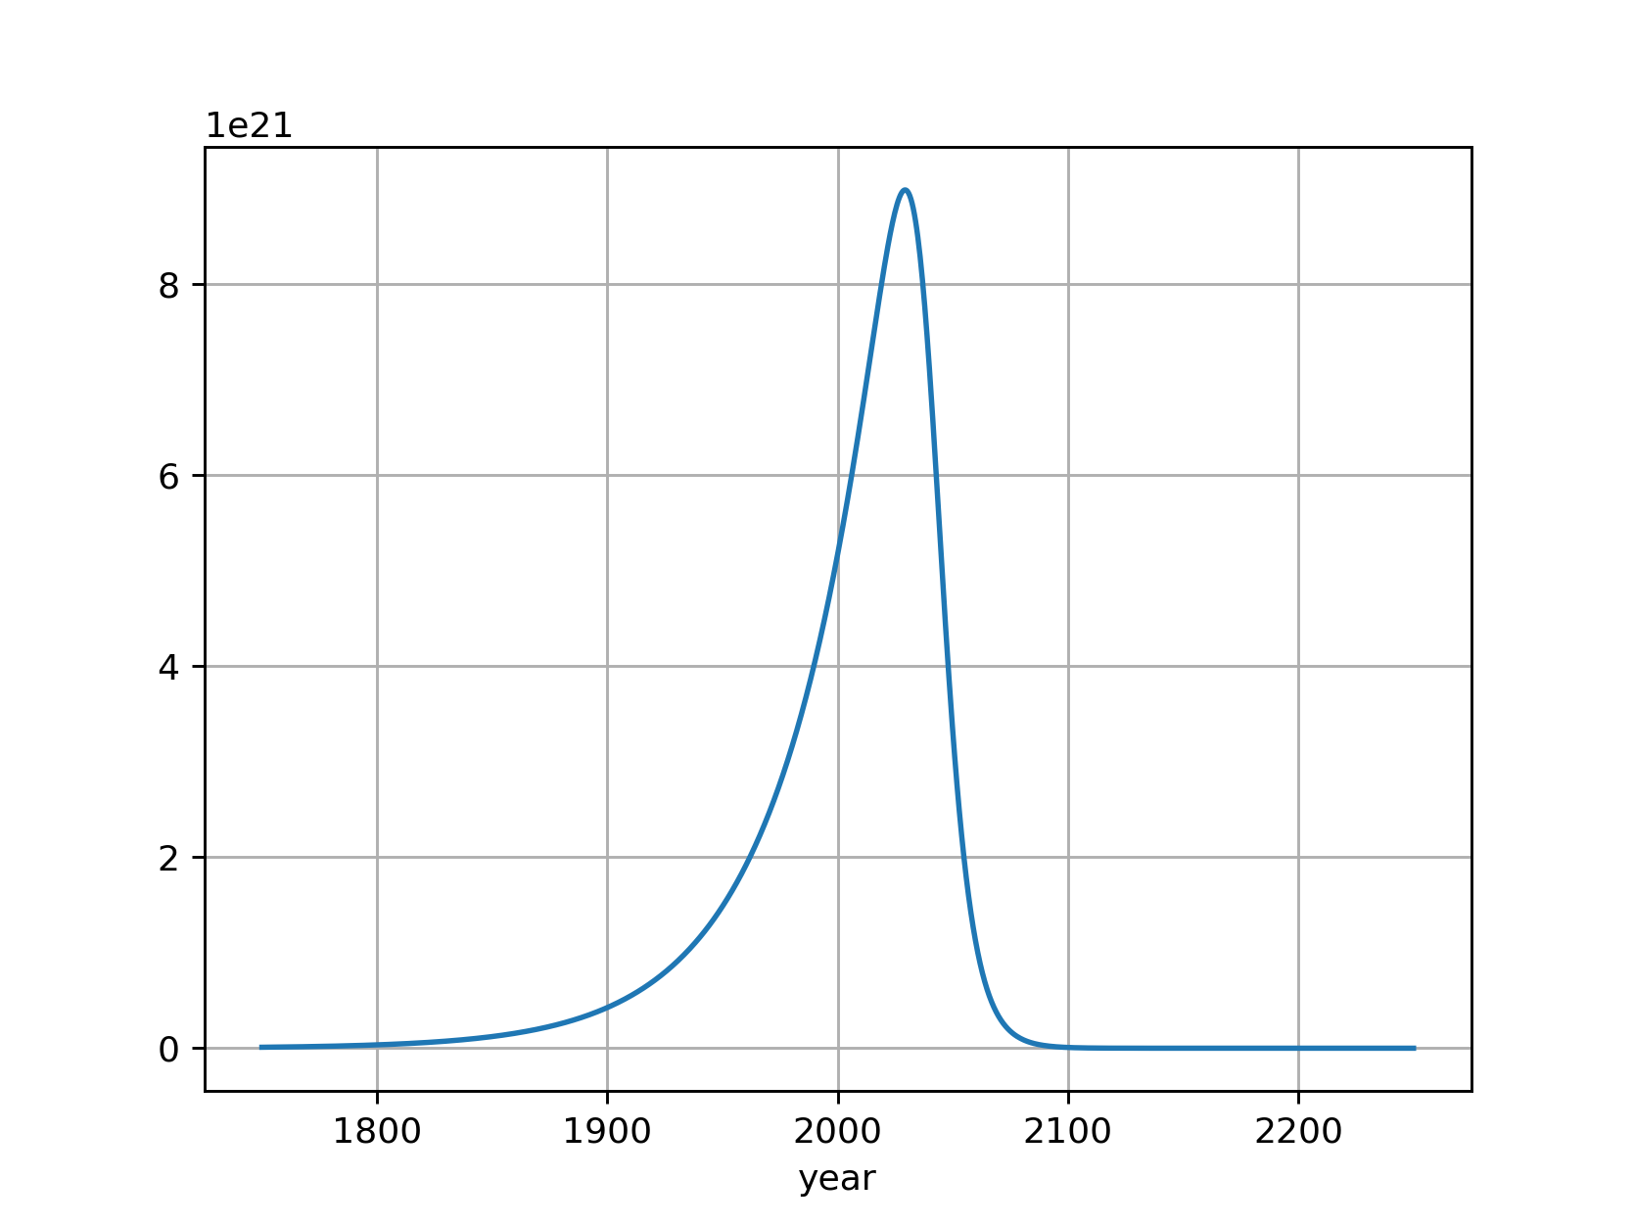
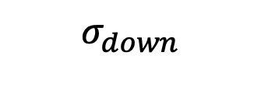


Product of exponential and sigmoid
$$exp⁡(kt)$$
So far, so good:
The shape seems right.
We can shift to later or earlier times by adjusting t_trans.
We can stretch out/compress the transition time by adjusting delta_t_trans.
$$σ_{down}$$
$${\exp\left(kt\right)× σ}_{down}$$

Slide 12
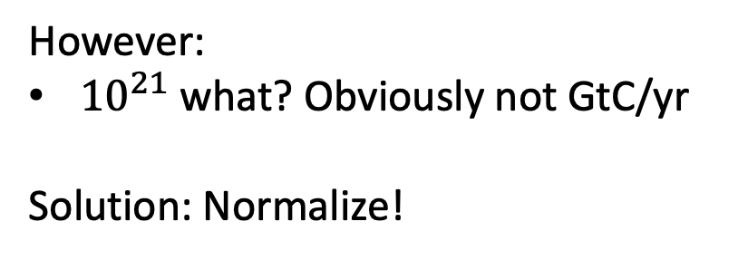
Product of exponential and sigmoid
$$exp⁡(kt)$$
However:
${10}^{21}$ what? Obviously not GtC/yr
Solution: Normalize!
$$σ_{down}$$
$${\exp\left(kt\right)× σ}_{down}$$

Slide 13

Normalizing

Slide 14
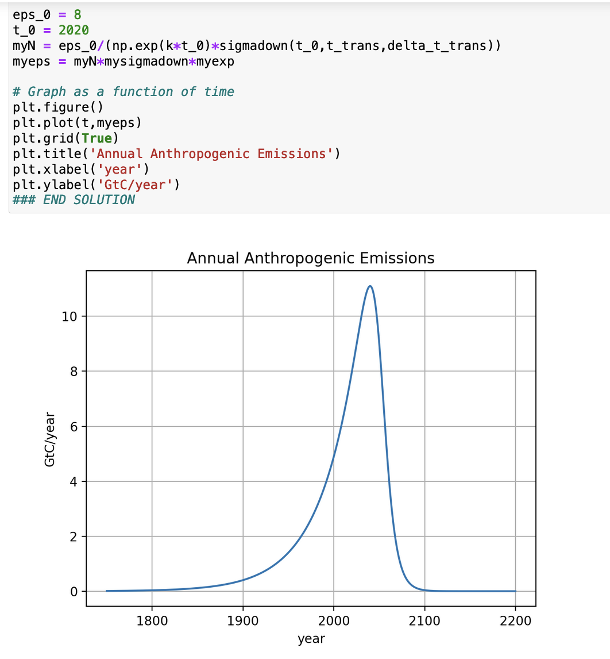
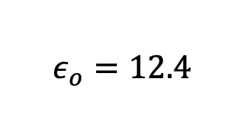



Verifying that this normalization works
$$ε_{o}=12.4$$
$$t_{o}=2018$$
$$t_{0}=2018$$

Slide 15
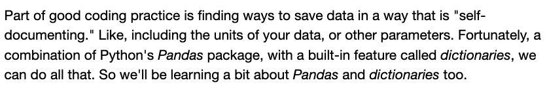
Metadata

Slide 16
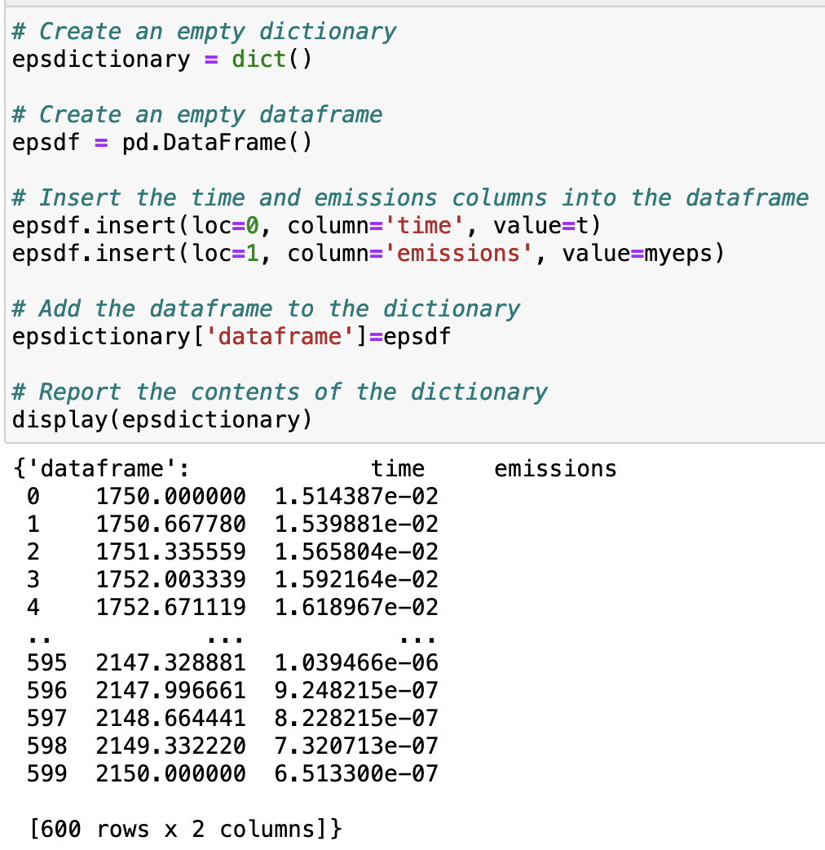
Metadata

